Slide 1
Website Presentation
dotNetwork – Social Network for Coders
Team members:
Ben Bowes
Suleman Khan
Daniel Mason
Bishan Meghani
Spencer Newton
Andrew Norman
Mario Reid

Slide 2
Website Objectives
dotNetwork is a social network for people interested in coding
It allows users to improve their coding techniques
dotNetwork invites users to sign up to view and create posts, and comment on other posts
Users can also join groups of like-minded users
Users can search for code as well as other users

Slide 3
User Case Diagram

Slide 4
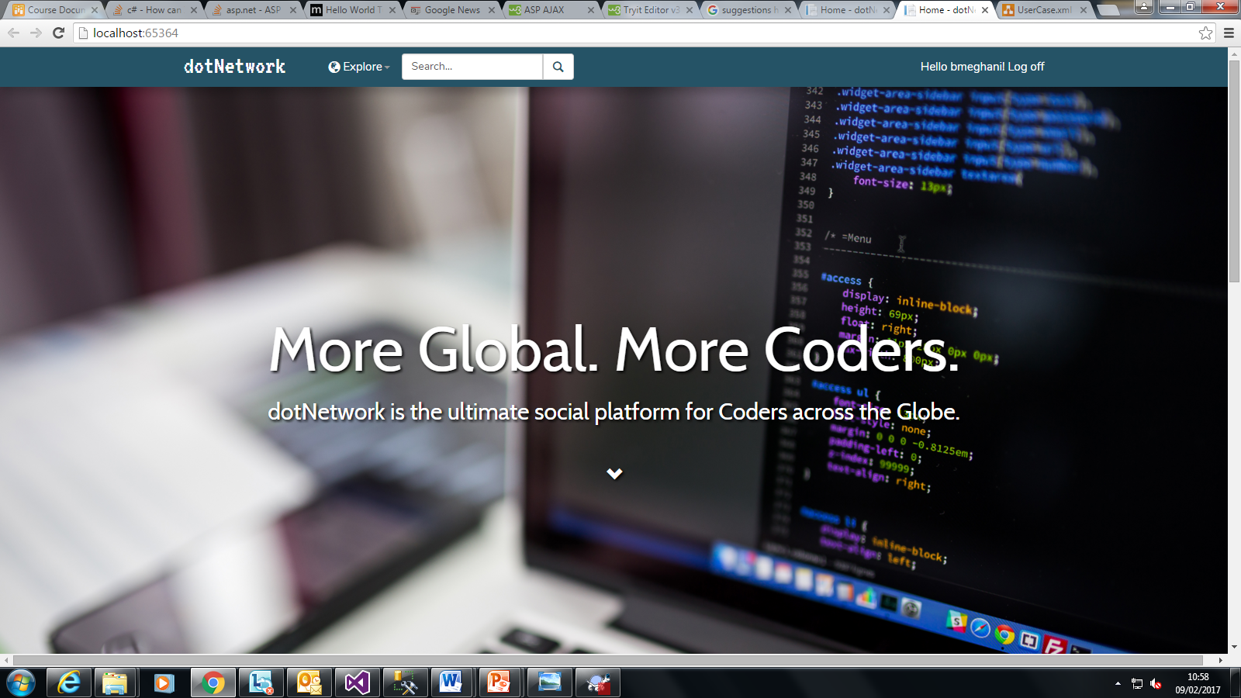
Website Demo…

